Slide 1




Towards Unsupervised Crowd Counting via Regression-Detection Bi-knowledge Transfer
Yuting Liu¹, Zheng Wang², Miaojing Shi³, Shin'ichi Satoh², Qijun Zhao¹, Hongyu Yang¹
¹College of Computer Science, Sichuan University,
²National Institute of Informatics, ³King's College London

Slide 2
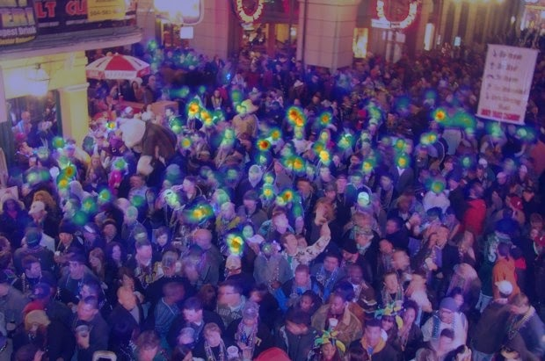
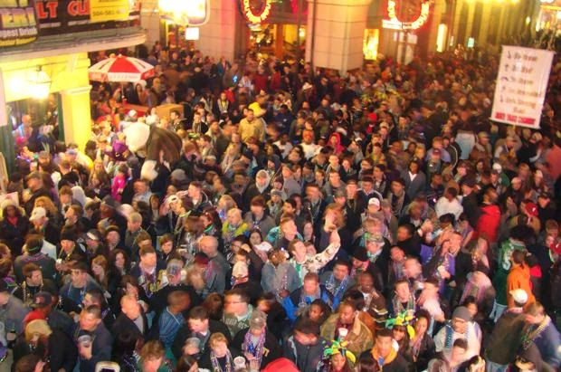
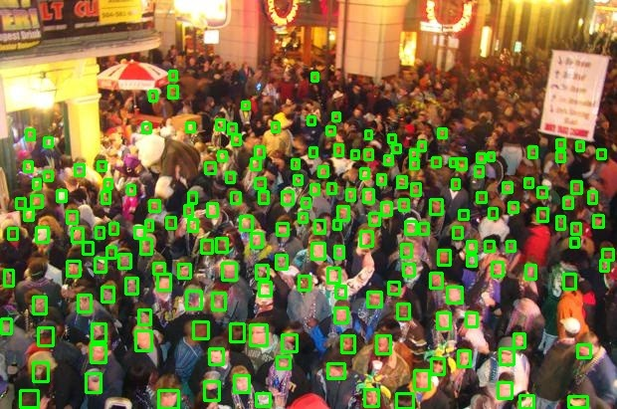
Crowd Counting(CC)
Estimate the number of people in a crowd scene
Two typical methods
By density regression
Density Map
By head detection
How many persons ???
Head Detections
2

Slide 3
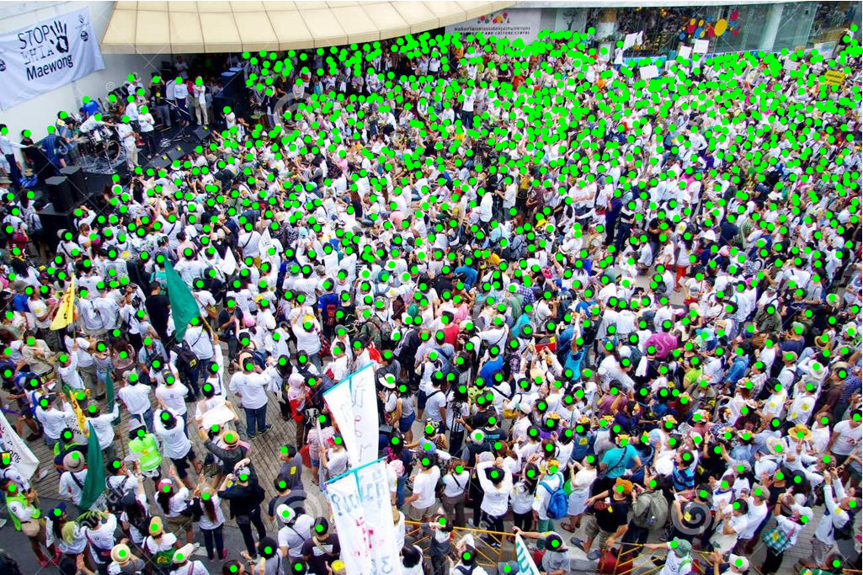
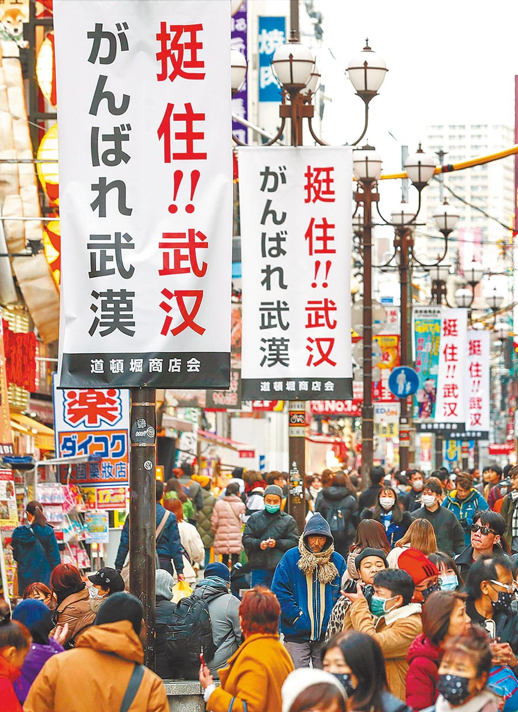
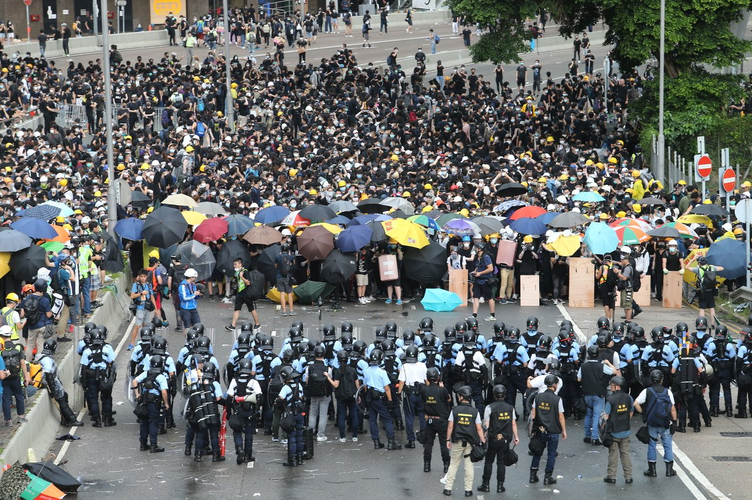
Bottom Necks to Open-world CC
Huge labelling Cost
Scene-dependent Crowd Counter
1111
Exhausted Dot Annotation
Scene variance
What do we care: Alleviating the annotation burden
In this work: Unsupervised cross-scene transferring

Slide 4
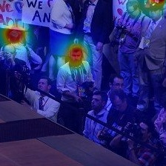
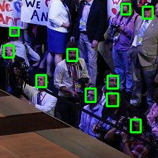
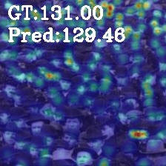
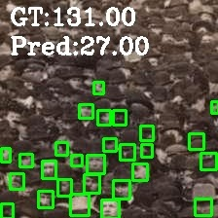
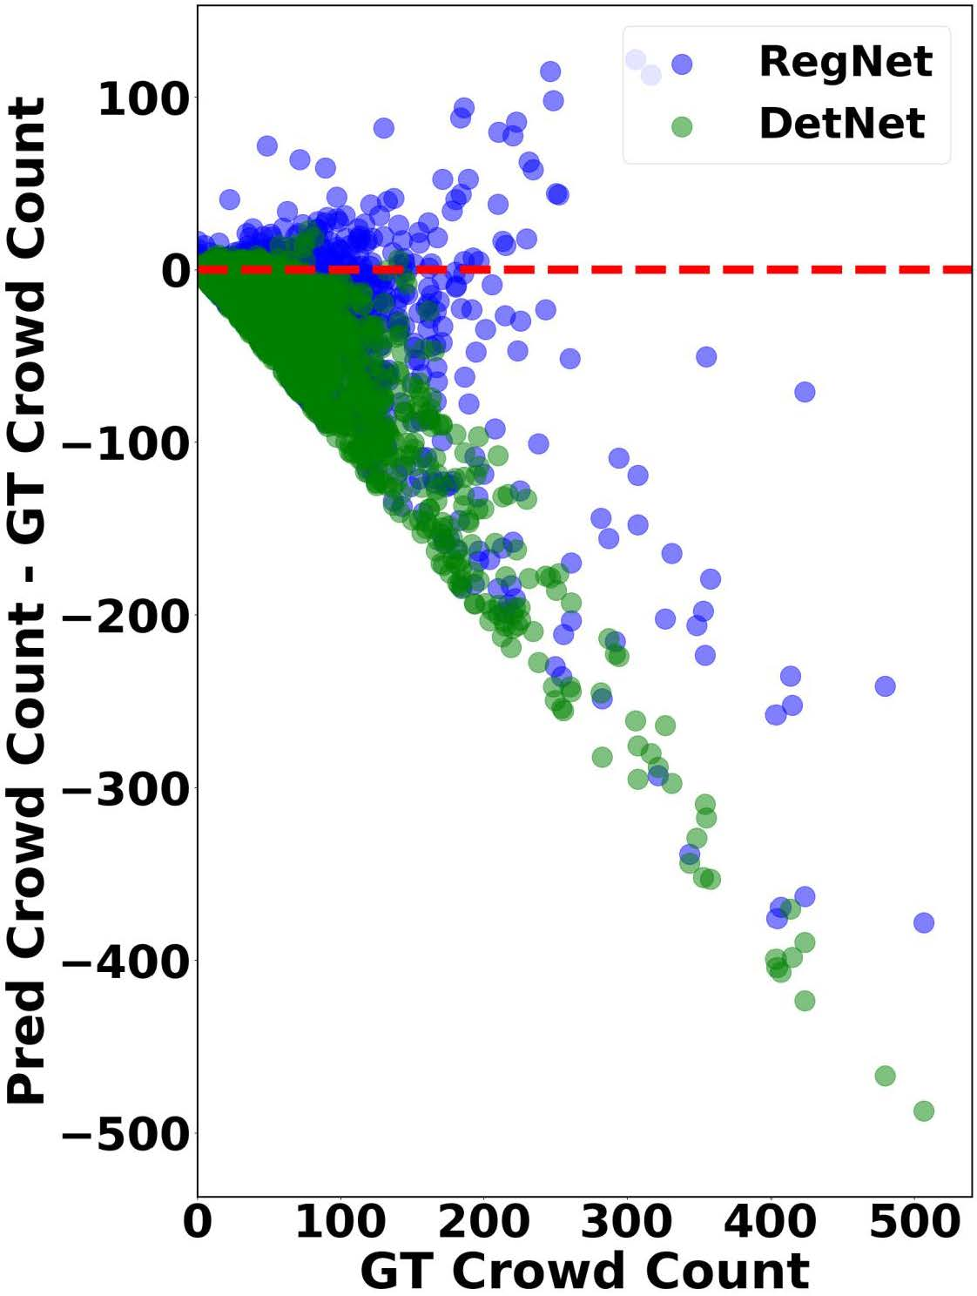
Observation : complementary property
Sparse Area
Denser Area
GT:10.00
Pred:4.03
GT:10.00
Pred:10.00
GT:10
Pred:4
GT:10
Pred:10
GT:131
Pred:129
GT:131
Pred:27
GT:10
Pred:4
How about letting RegNet and DetNet Co-teaching each other in the Target?

Slide 5
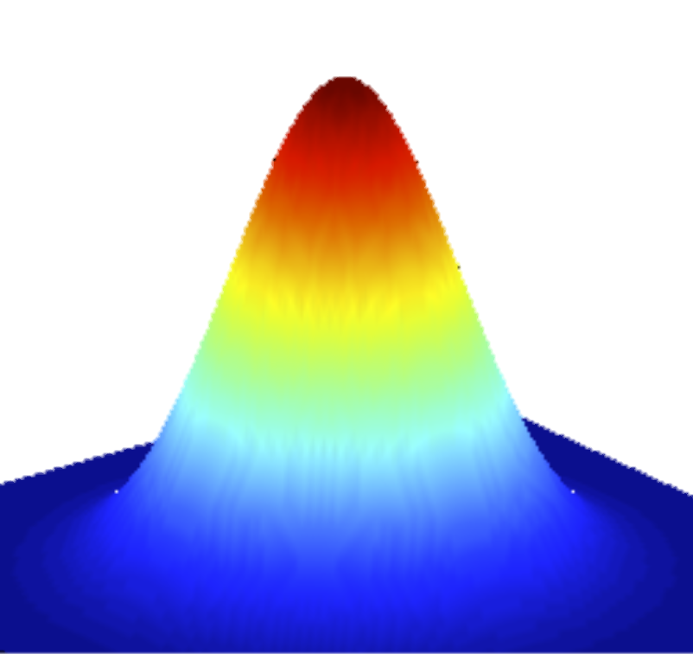
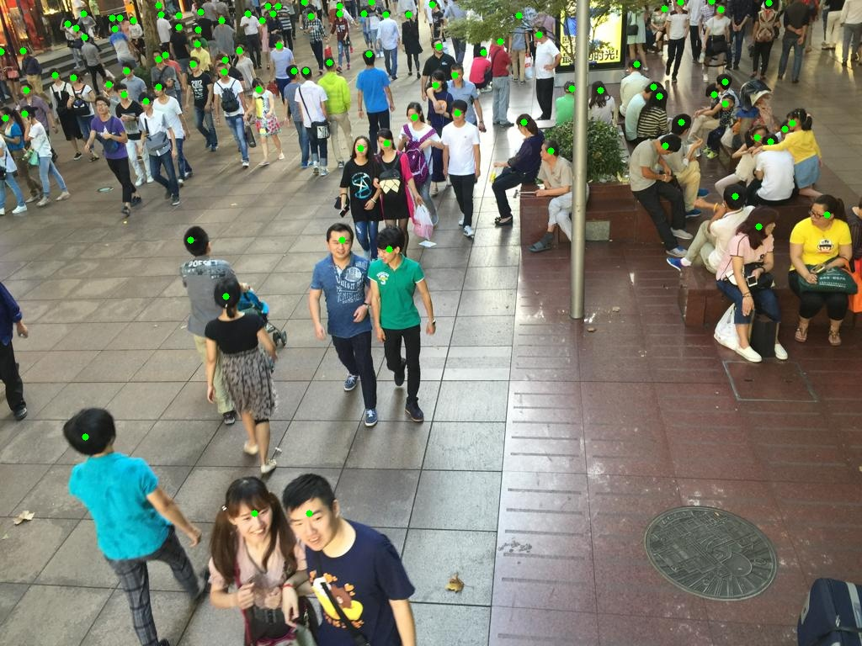
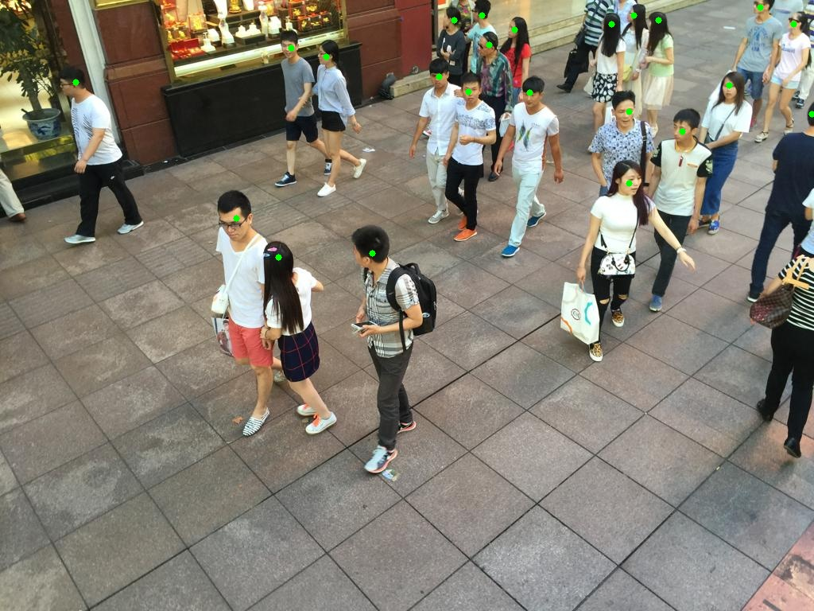
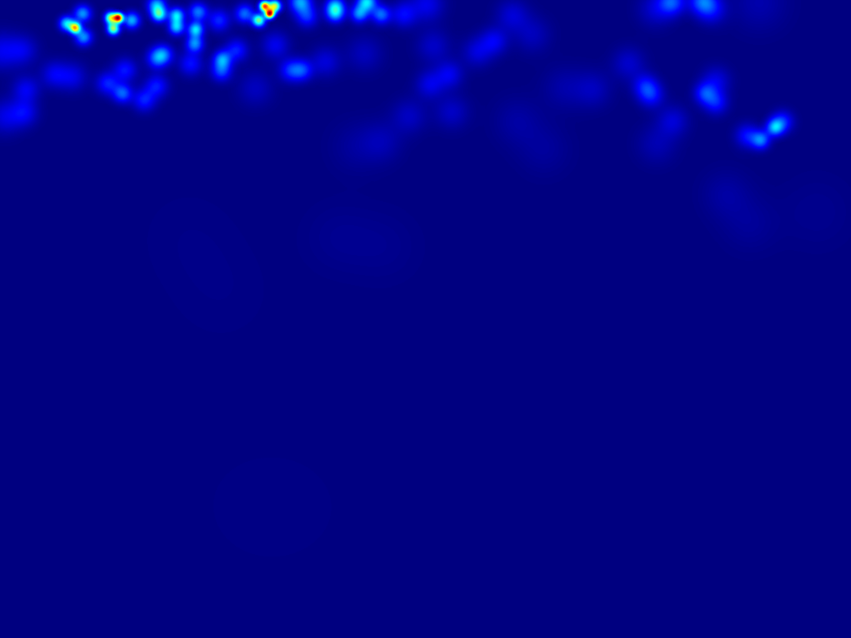
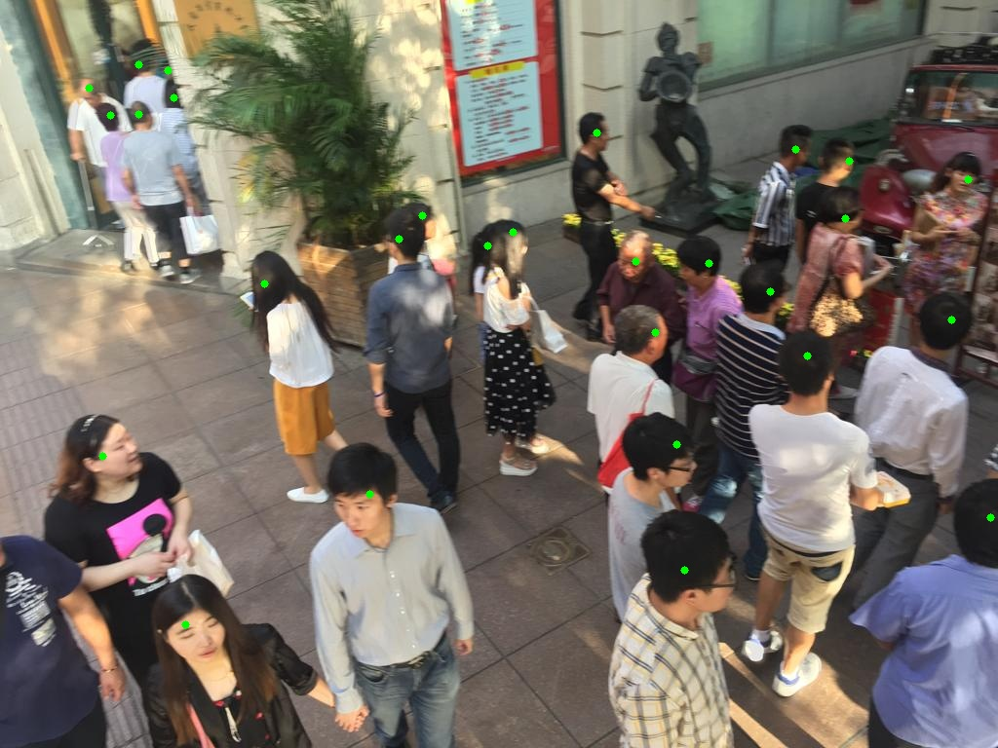

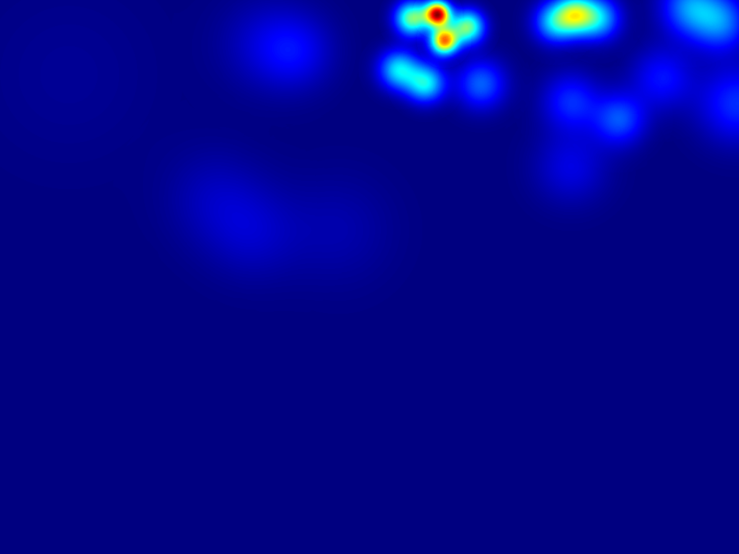
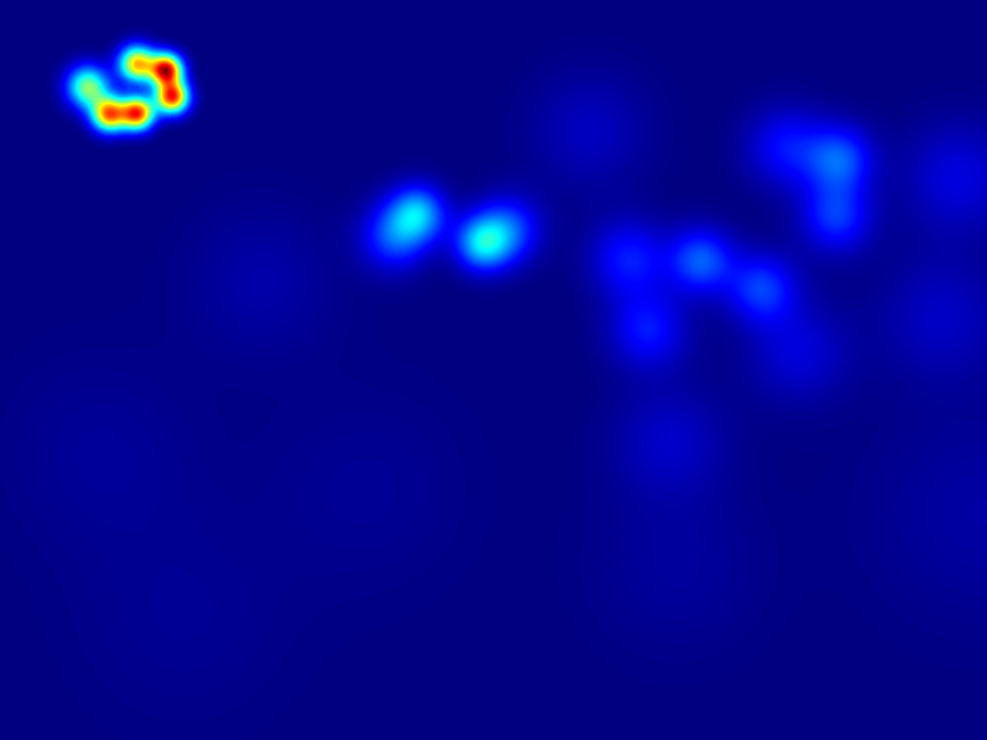
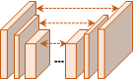
Motivation: Reg-Det Bi-knowledge Transfer
How to co-teach RegNet & DetNet?
--Scene agnostic mutual transformations modelling in Source
-- Reg-Det bi-knowledge transfer in Target
Detection dot map
Density map
Det-to-Reg ψ
Binary map
Reg-to-Det Φ

Slide 6

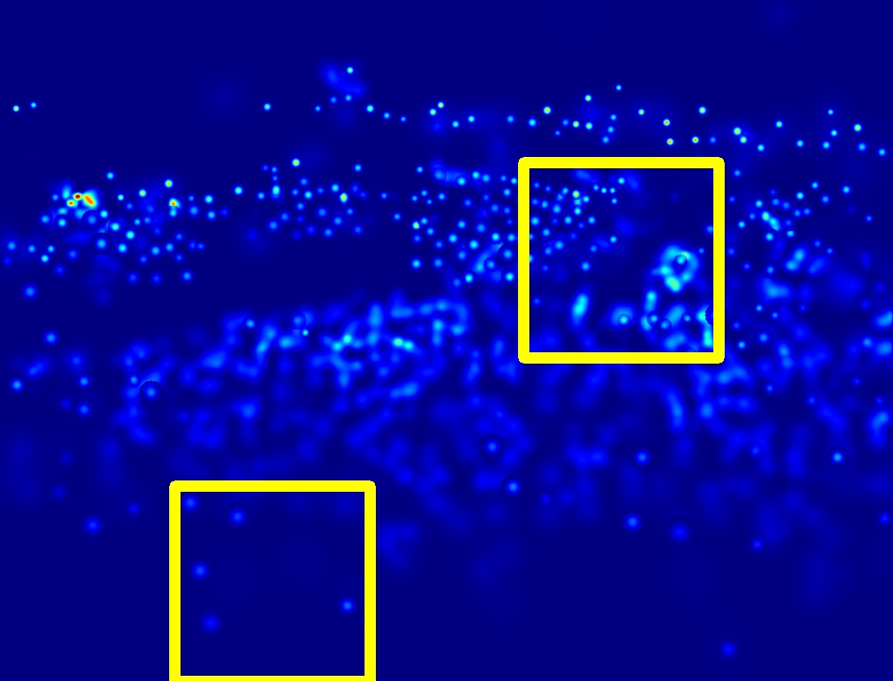

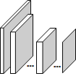
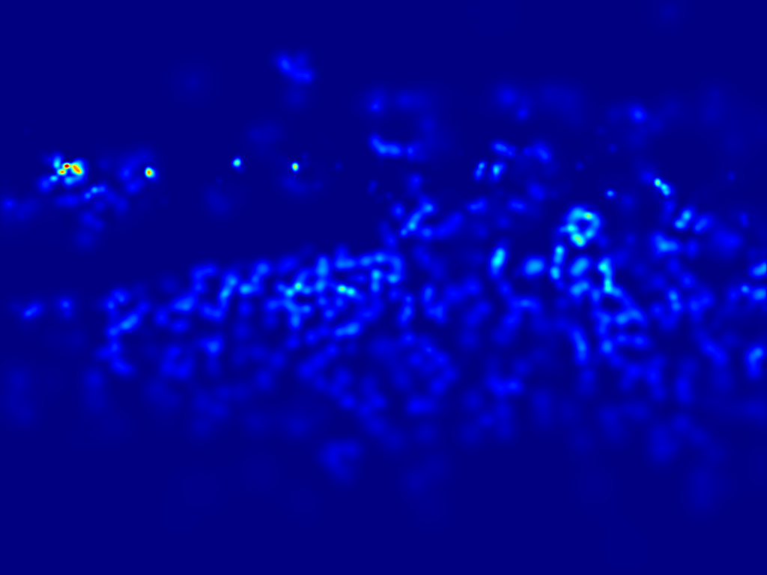
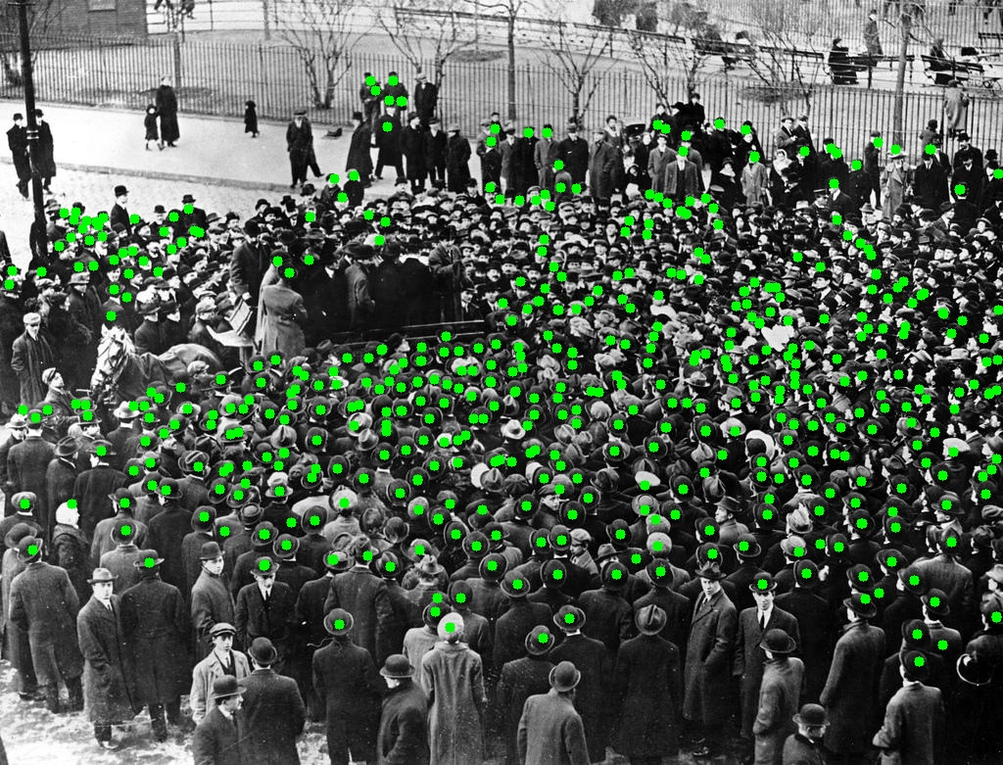
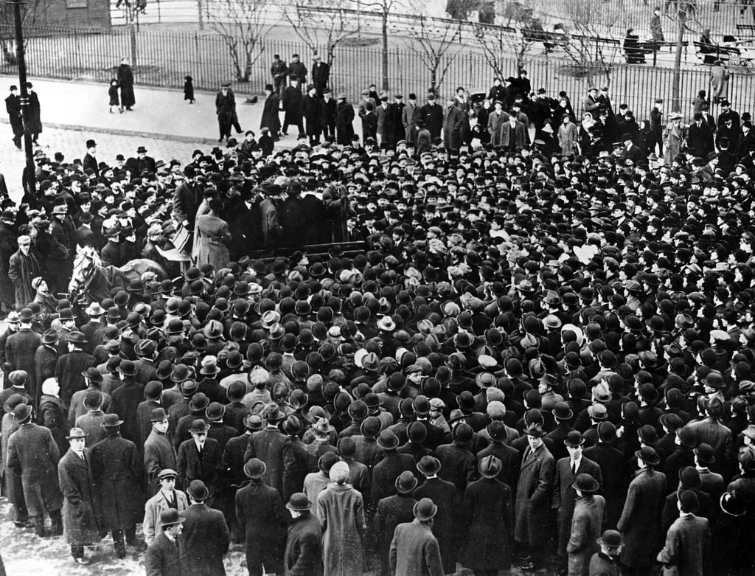
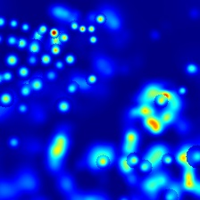
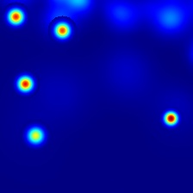
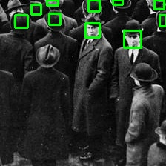
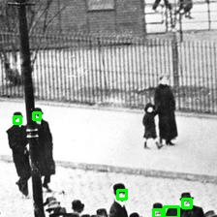
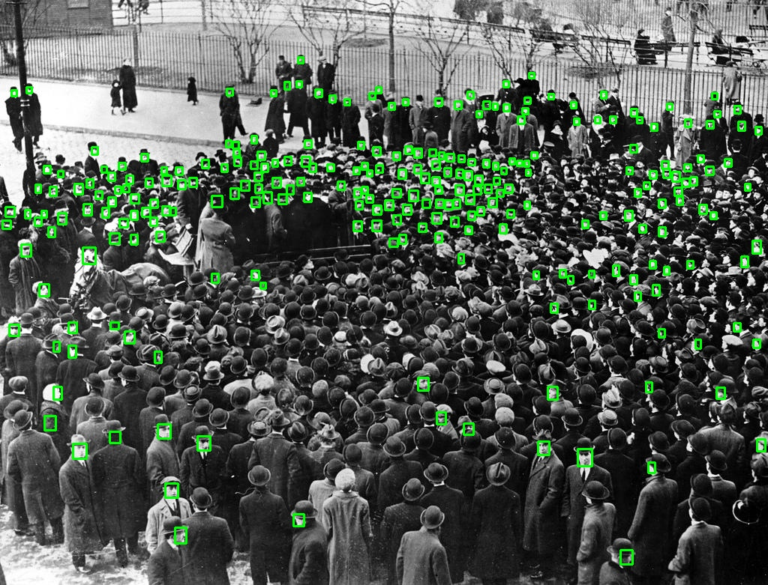
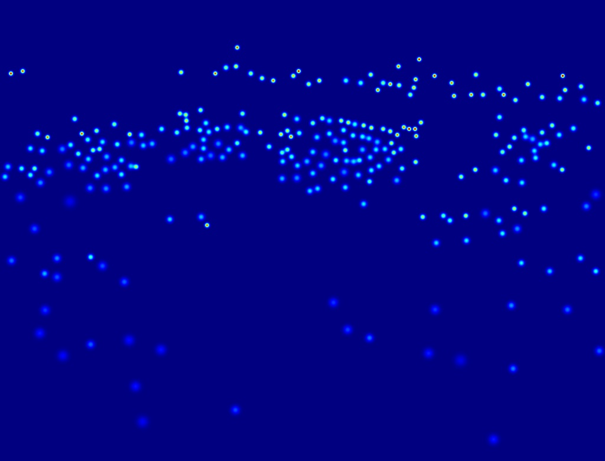
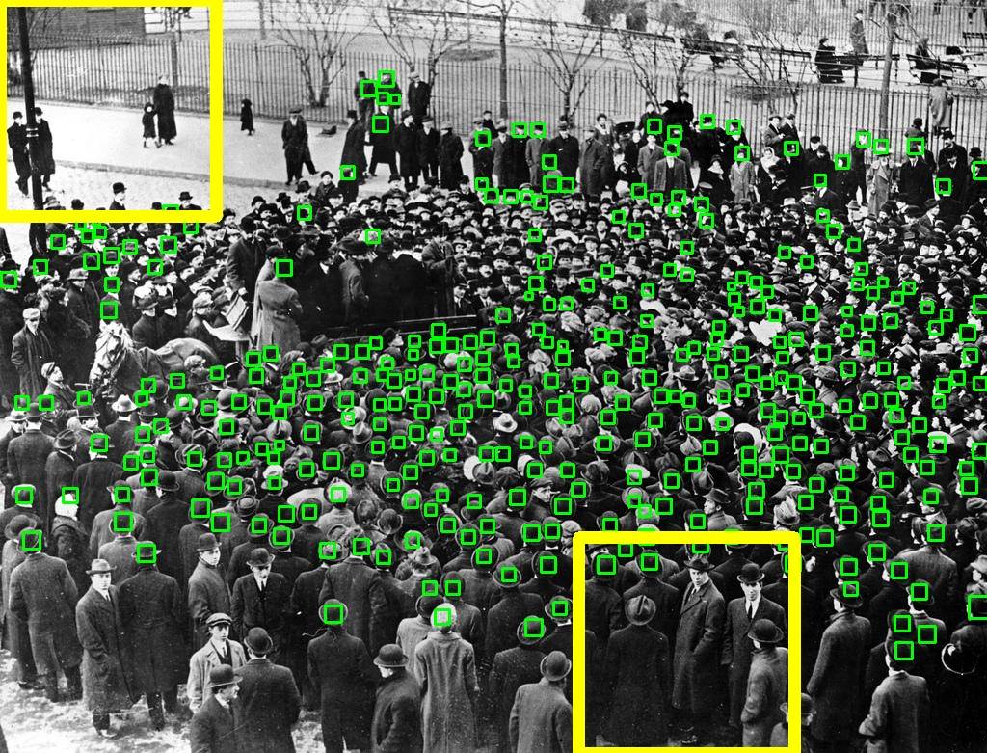
Our Approach: overview
Reg-Det mutual transformations modelling in
Reg-Det bi-knowledge transfer in
Density Map
Fusion
Reg-to-Det
Reg-to-Det Φ
RegNet R
Det-to-Reg
Det-to-Reg ψ
DetNet D
Location Map
Fusion
Step 1: Density and location inference
Step 2: Pseudo ground truth generation
Step 3: Self-supervised fine-tuning

Slide 7

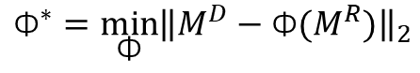

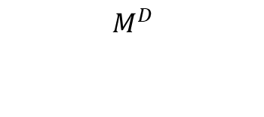
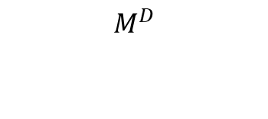

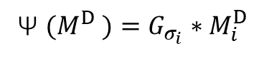
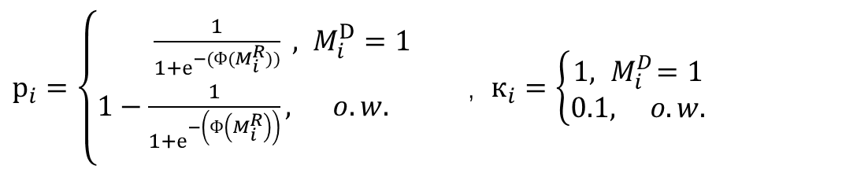
Our Approach: mutual transformations modelling
Reg-to-Det Φ
Det-to-Reg ψ
Ψ ${(M}^{D} )=G_{σ_{i}}∗M_{i}^{D}$
$${\text{Ф}}^{∗}=\min_{\text{Ф}}{{\left\|M^{D}−{\text{Ф}(M}^{R})\right\|}_{2}}$$
$$M^{D}$$
$$M^{R}$$
$$M^{R}$$
$$M^{D}$$
$$loss=l_{focal−mse}+l_{dms−ssim}$$
$$l_{focal−mse }=к_{i} {(1−р_{i})}^{γ} {{(M}^{D}−{\text{Ф}(M}^{R})}^{2}$$
$р_{i}=\left\{\begin{aligned}\frac{1}{1+е^{−(Ф(M_{i}^{R}))}} , M_{i}^{D}=1 \\ 1−\frac{1}{1+е^{−\left(Ф\left(M_{i}^{R}\right)\right)}}, o.w. \\ \end{aligned}\right.$, $к_{i}=\left\{\begin{aligned}1, { M}_{i}^{D}=1 \\ 0.1, o.w.\end{aligned}\right.$

Slide 8
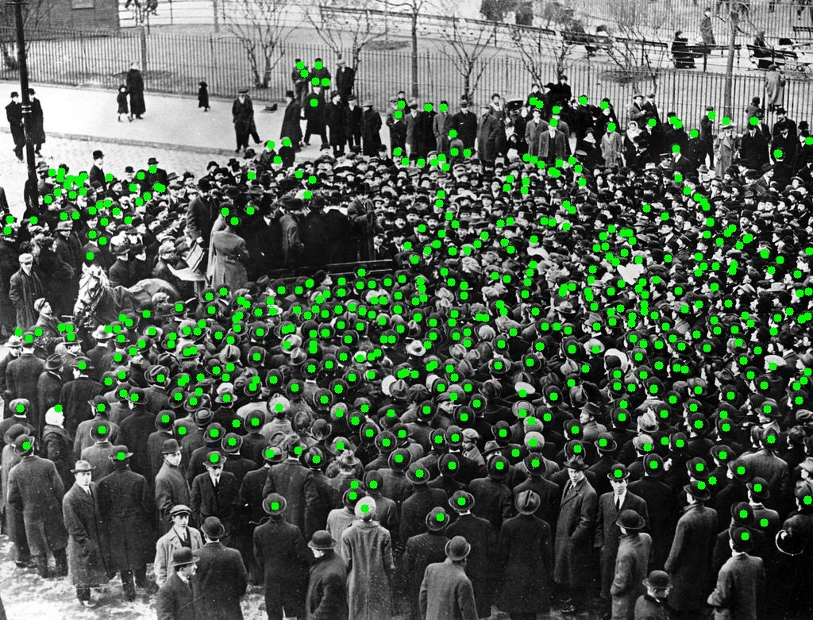
Our Approach: Reg-Det bi-knowledge transfer
Det-to-Reg ψ
RegNet R
Reg-to-Det Φ
DetNet D
Step 1: Density and location inference

Slide 9
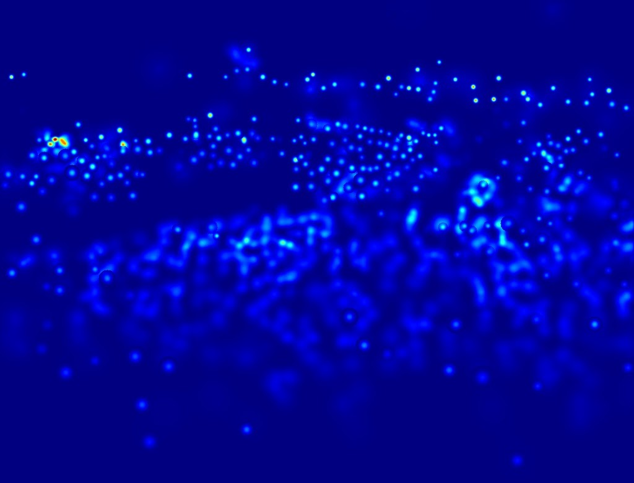
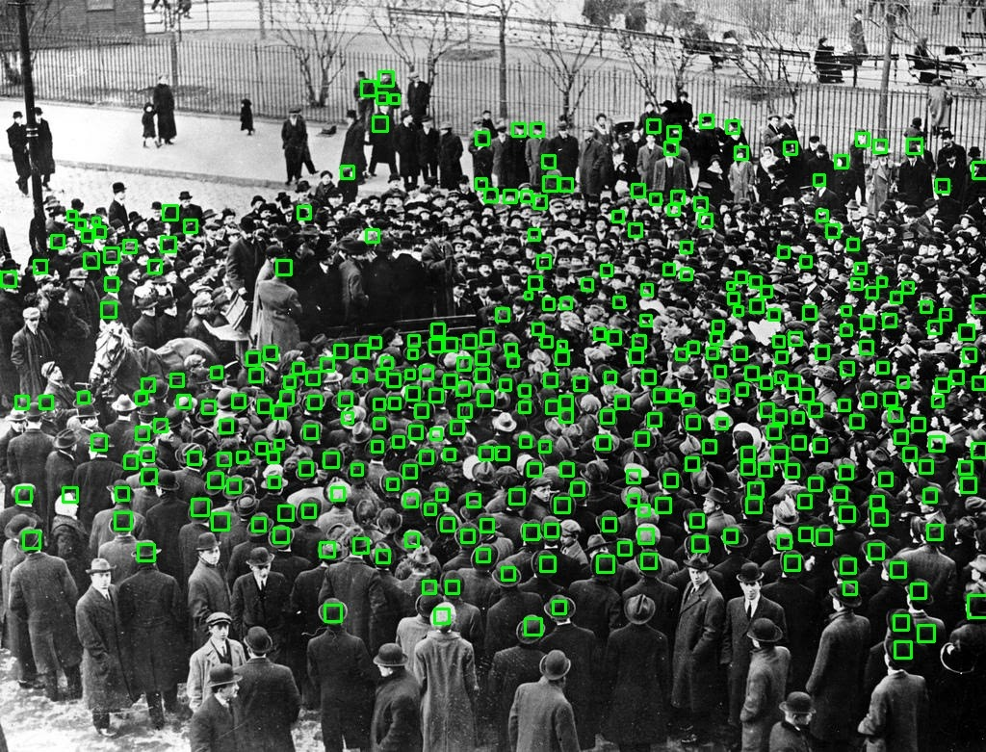
Our Approach: Reg-Det bi-knowledge transfer
Density Map
Fusion
Det-to-Reg
Reg-to-Det
Location Map
Fusion
Step 2: Pseudo ground truth generation

Slide 10
Our Approach: Reg-Det bi-knowledge transfer
Density Map
Fusion
Reg-to-Det
RegNet R
Det-to-Reg
DetNet D
Location Map
Fusion
Step 3: Self-supervised fine-tuning

Slide 11
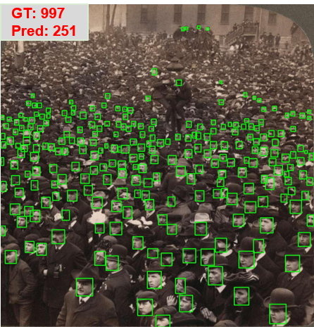
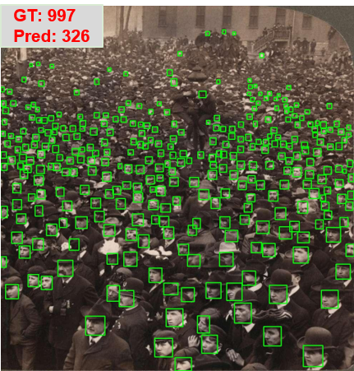
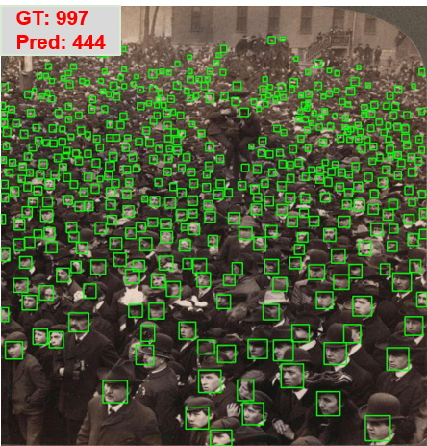
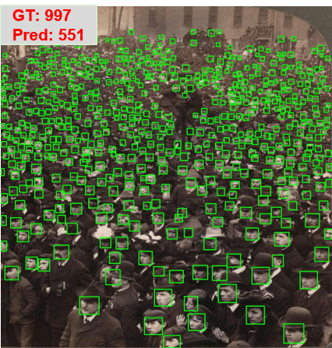
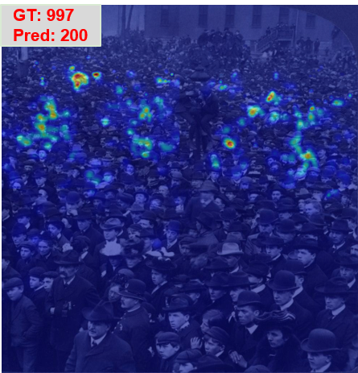
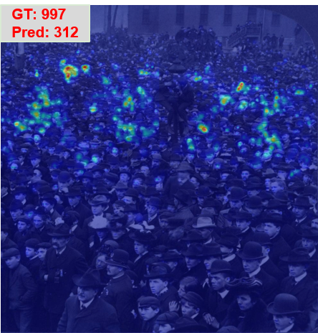
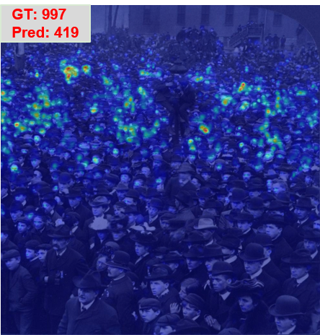
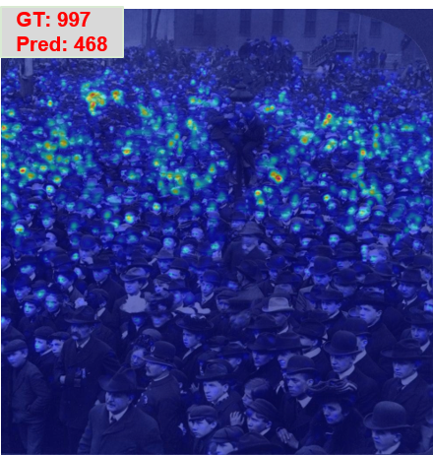
Experiments
DetNet
RegNet
Iteration 0
Iteration 1
Iteration 2
Iteration 3

Slide 12
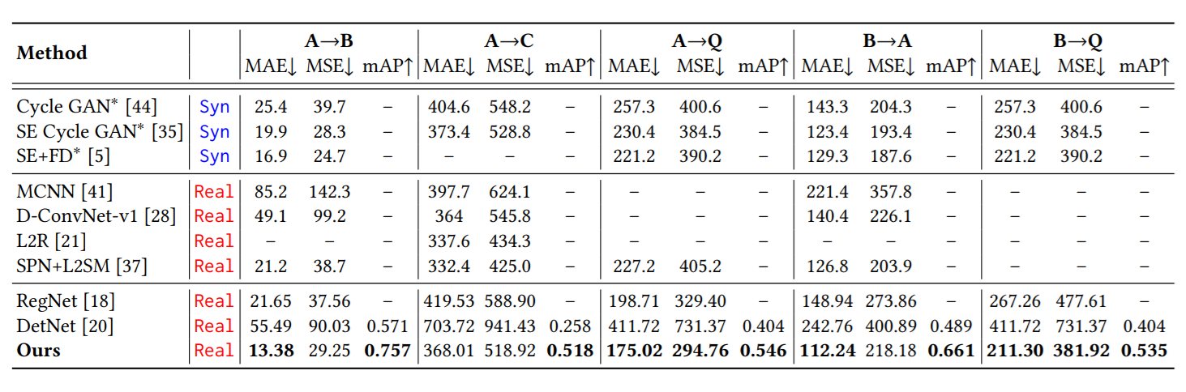
Experiments
Table 1: Comparisons with the state-of-the-art methods in the transfer setting. Syn denotes transfer learning using a large size synthetic dataset. Real denotes transfer learning using a real source dataset. The methods with ∗ indicate the source is the synthetic dataset GCC.

Slide 13
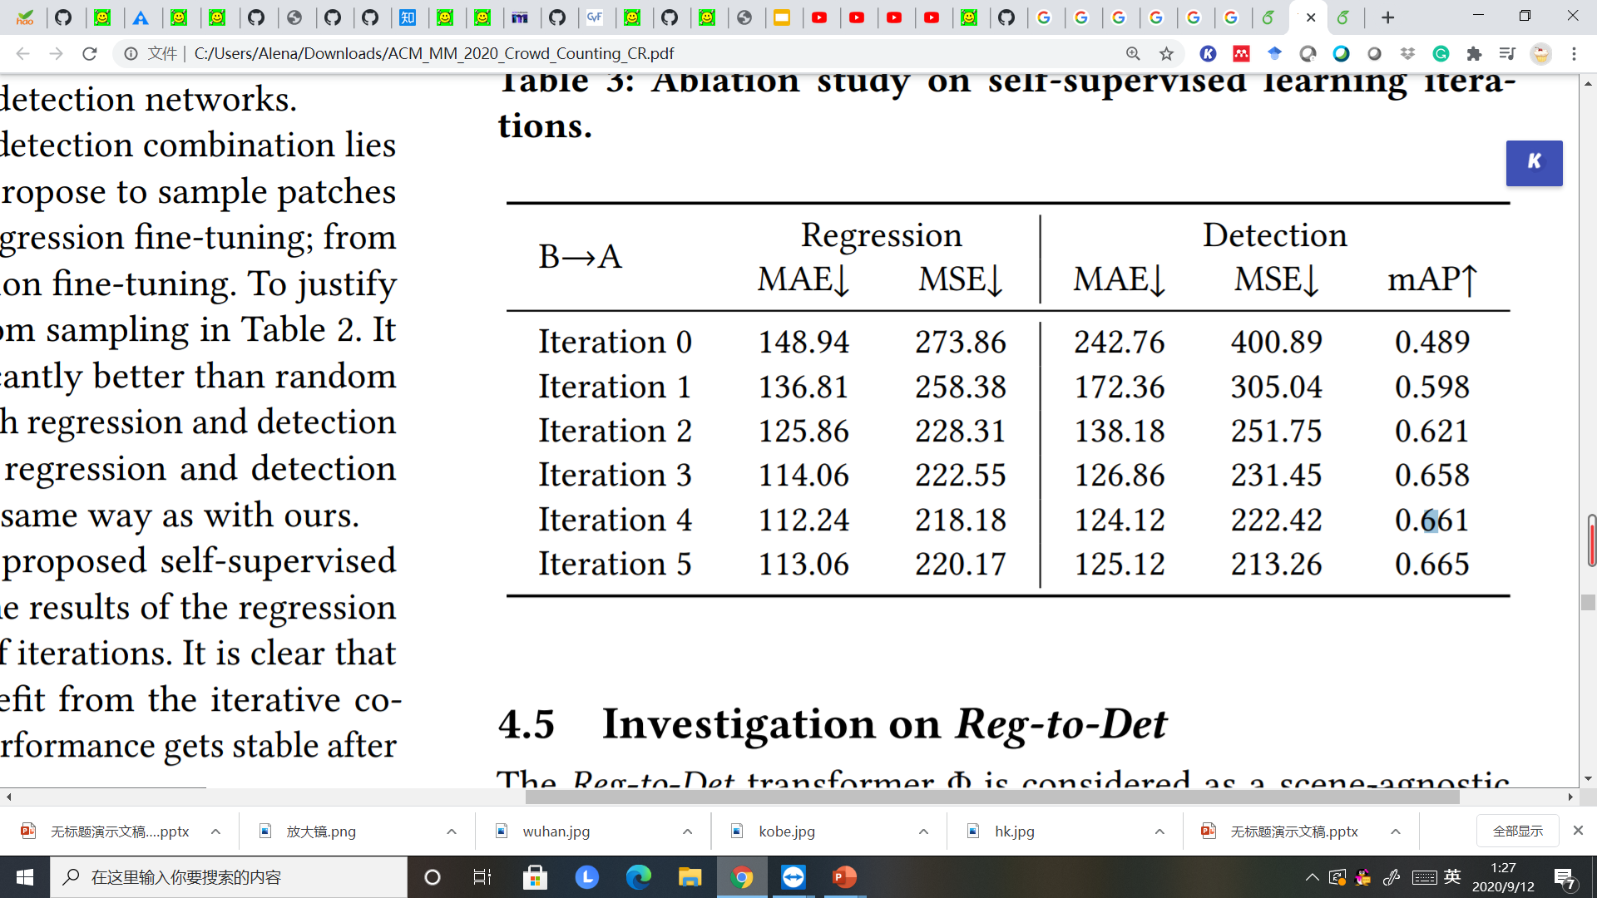
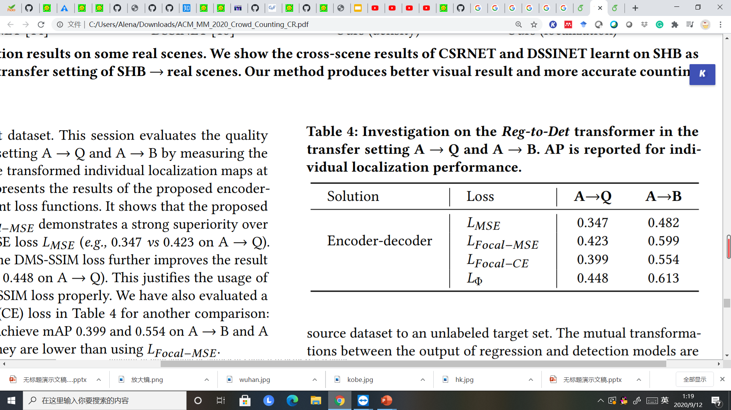

Experiments
How to learn a good Reg-to-Det Φ?
How to adapt the model to the target?
Table 2: Investigation on training the Reg-to-Det transformer
Table 4: Ablation study on self-supervised learning iterations
How to generate samples for fine-tuning?
Table 3: Ablation study on generating pseudo GT

Slide 14
Conclusion
New unsupervised crowd counting scheme via regression-detection bi-knowledge
Formulate the mutual transformations between the output of regression and detection models to enable knowledge distillation between them
Co-training regression and detection models using pseudo labels in an iterative self-supervised way
14

Slide 15
Thank you!
# 732

